Slide 1
Sangam Project
presentation

Slide 2
Uxo, the minesweeper
Sangam project by:
Akshaya K S
K Vidyaa
Swatthi Vijay Sanker

Slide 3
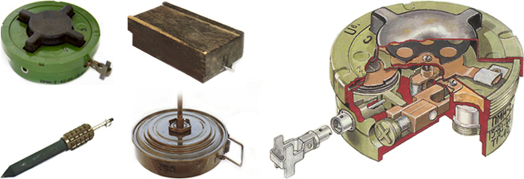
What is a mine?
A landmine is an explosive device buried underground usually detonated by pressure.
It can range from anti-personnel to anti-tank mines.

Slide 4
Need for our project:
Spread over 78 countries landmines kill 50 to 20000 people every year with 80% of the victims being civilians.
Disadvantage of blast demining:
Some mines come with a fuze mechanism which are made to survive any explosions near by.
The debris that are left by can make it harder to establish civilization
Soil bearing capacity reduces
Decreases fertility of soil
Can be used in war zones or more importantly with people nearby

Slide 5
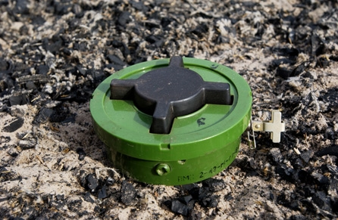
Our robot:-
Our Robot aims to implement detection and removal of anti-personnel landmines. IR thermography is used for the detection of the mine and a mechanism similar to a tree transplanter is used to remove the mine.

Slide 6
Other applications
Our robot can also be applied in varied fields:
Architecture: removal of buried artifacts
Agriculture: weed removal
: tree transplanter
Construction: removing trees in the construction site

Slide 7
Main modules
Navigation: 1. Low pressure traversal
2. RF control
Detection: 1. IR Thermography
Removal: 1. Digging
2. Forklift

Slide 8
Low pressure traversal
It is important to ensure that the robot does not detonate the landmine while moving over it due to its weight.
To do so, the area in contact with the ground while traversing has to be increased.
Further, a mechanism is used to distribute the weight of the vehicle evenly to avoid triggering partially buried mines or those with low trigger pressure.
It is done using notched foam rubber over the tread.

Slide 9
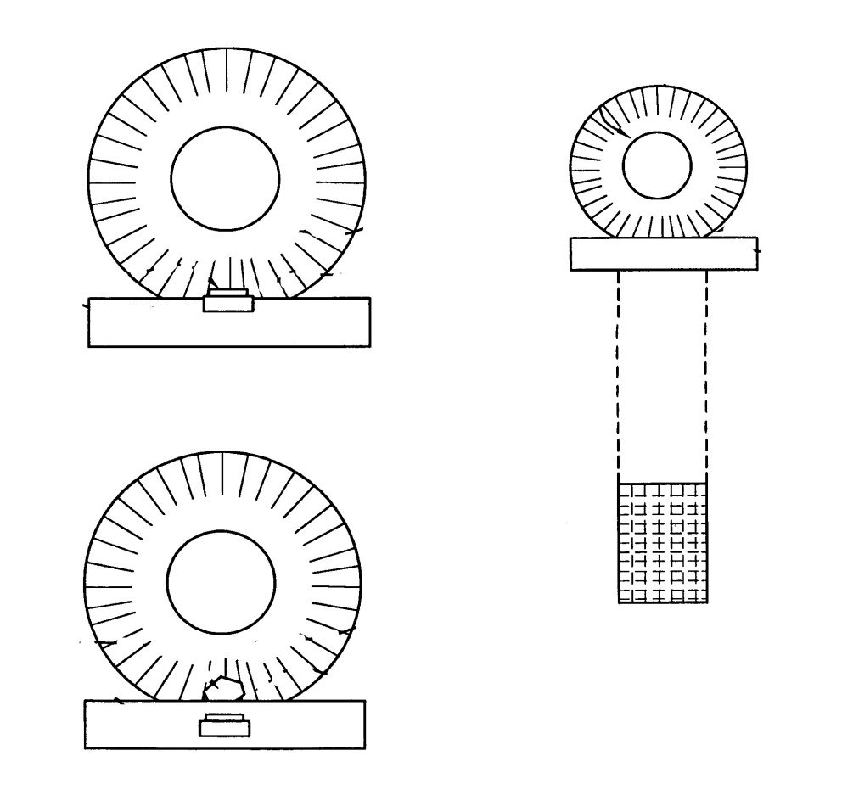
The design idea:

Slide 10
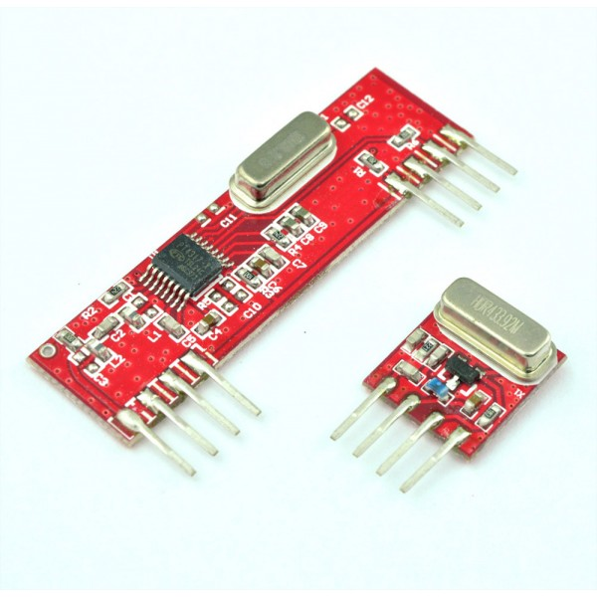
Rf module
We are using a joystick to traverse over the required area. The signals from the joystick is transmitted to the robot using an RF module.

Slide 11
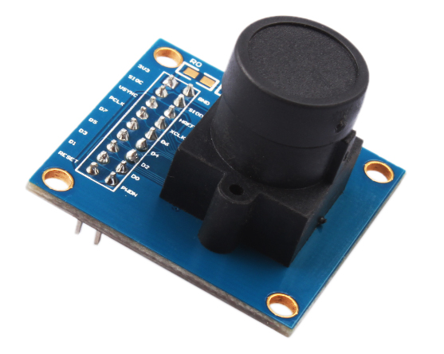
Ir thermography
It is based on the fact that thermal signature of buried objects differ compared to the soil around it.
This temperature signature can be measured by an IR imaging system placed above the soil area.
We have used the ov7670 module to detect this abnormality thereby locating the mine.

Slide 12
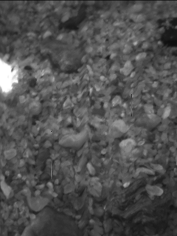
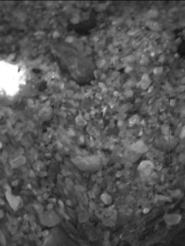
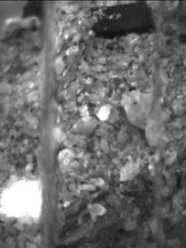
Some of the images of the IR led buried under the soil (used to stimulate the radiation given out by the mine are shown below):
The bright white spot indicates the IR radiation source.

Slide 13
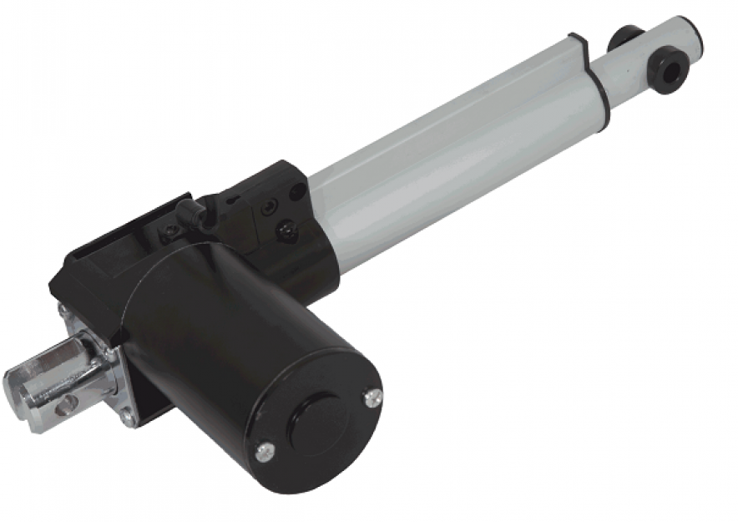
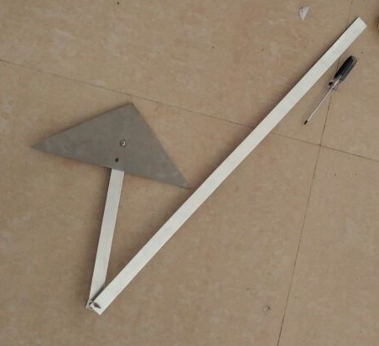
Digging and removal
After detecting the presence of a landmine it needs to be removed. For doing so, we adopted a mechanism inspired by a tree transplanter idea.
We have chosen to actuate three spades using one 24V electric linear actuator with a stroke length of 100mm.

Slide 14
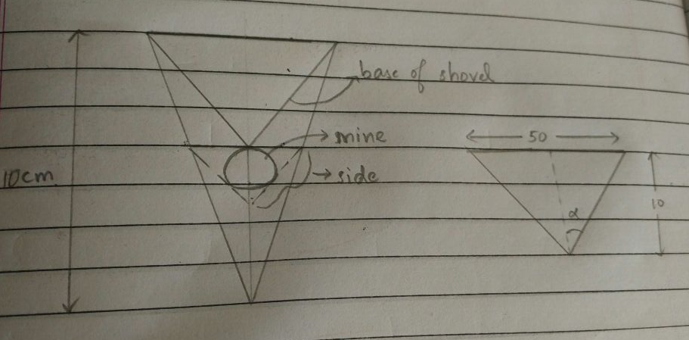
In this idea it is imperative, to calculate the soil digging force required for an assumed average burial depth of 7 cm for antipersonnel mines.
We calculated it to be approximately 625 N.

Slide 15
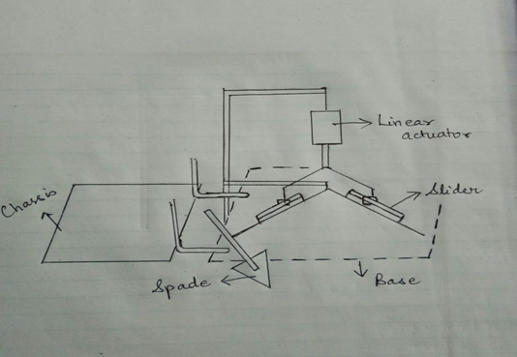
Our design

Slide 16
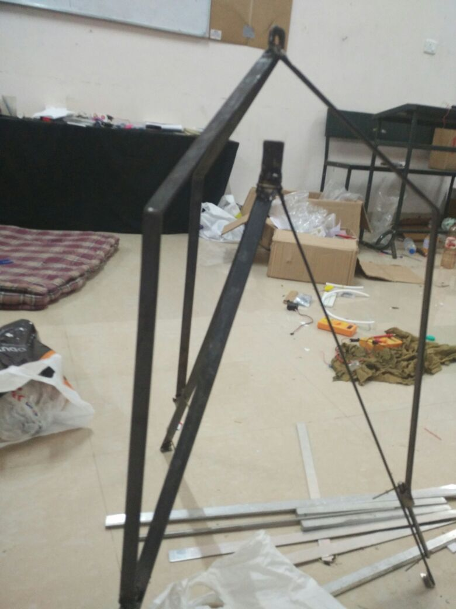
Our robot so far…
The mechanism for the base is completed the chassis with the track belts needs to be attached to finish the forklift mechanism.
The image processing to isolate the mine is finished with decent accuracy.

Slide 17
Improvements in the project
Navigation can be made autonomous by implementing SLAM
Instead of reducing the pressure exerted by the vehicle on the mine a mechanism can be developed to avoid traversing over the mine.
It can be implemented using multiple wheels and making sure only those set of wheels touch the ground which will not come directly over the mine.
Further research on inverse thermography can be done to determine the geometrical properties of the mine to better facilitate mine removal and reduce false alarms.

Slide 18
references
https://en.wikipedia.org/wiki/Land_mine
http://article.sapub.org/pdf/10.5923.j.fs.20130301.05.pdf
https://patents.google.com/patent/US6952990B1/en
https://www.ricam.oeaw.ac.at/files/reports/11/rep11-25.pdf
http://journals.sagepub.com/doi/full/10.5772/50907
http://ieeexplore.ieee.org/document/4683351/?part=1

